Slide 1
Collisions

Slide 2

In this Smart Lesson you will learn to:
Define the terms elastic collision and inelastic collision.
Compare elastic and inelastic collisions.
Solve problems involving elastic collisions and inelastic collisions.

Slide 3
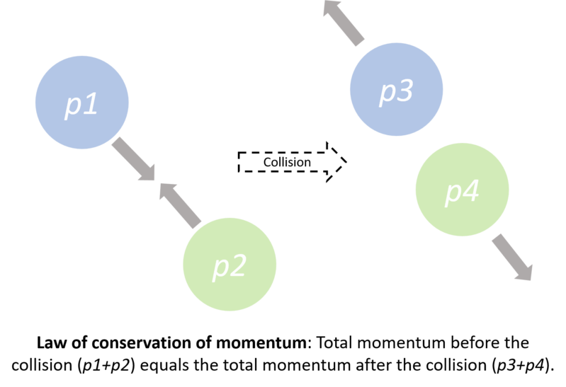
An elastic collision is defined as a collision in which both momentum and kinetic energy are conserved.
For example, collisions in ideal gases approach perfect elastic collisions. Also, some large-scale interactions such as the slingshot gravitational interactions between satellites and planets are elastic.

Slide 4
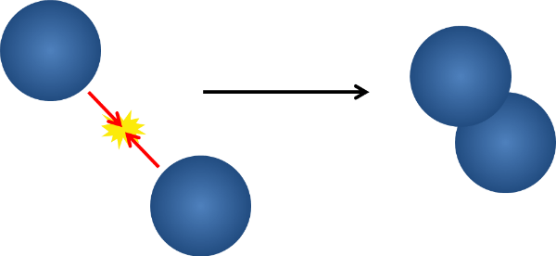
An inelastic collision is defined as a collision in which kinetic energy is not conserved.
In a perfect inelastic collision, the two bodies join together to form a single body after the collision. Whilst momentum is conserved, the kinetic energy is not, as some is lost to other forms of energy such as heat and sound.

Slide 5
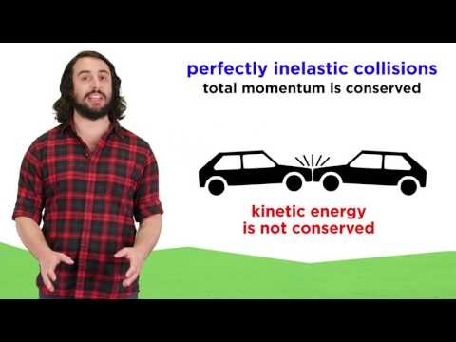

Slide 6

So how can we solve problems involving collisions?
First let's consider an elastic collision.
We know that momentum and kinetic energy are conserved.
If the masses of the 2 objects are m₁​ and m₂​, and they are travelling at initial velocities v_{1​} and v₂​ and final velocities v₃​ and v₄​ respectively, then applying conservation of momentum:

Slide 7
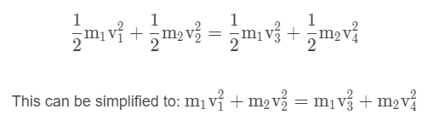

Applying conservation of energy:
These equations can then be used either separately or simultaneously with the momentum equations to solve elastic collision problems.

Slide 8
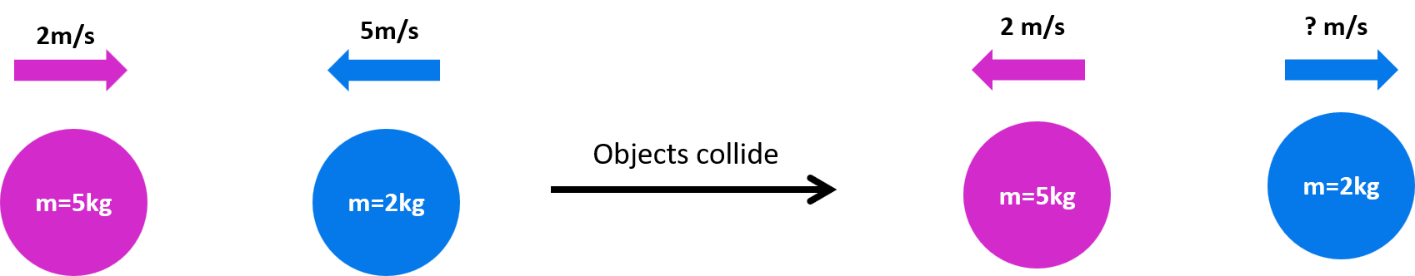
Let's consider an example:
2 balls collide as shown and the collision is elastic.
Calculate the final velocity of the blue ball.

Slide 9
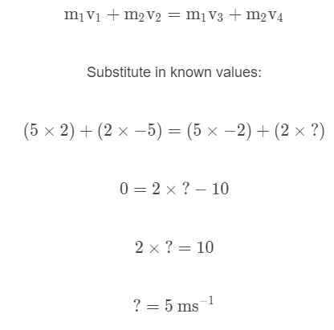
As there is just one unknown, the velocity can be calculated using the law of conservation of momentum.

Slide 10
Let's look at another example.
Two balls, each with mass 2 kg, and velocities of 2 ms⁻¹ and 3 ms⁻¹ collide head on. Their final velocities are 1 ms⁻¹ and 2 ms⁻¹, respectively. Is this collision elastic or inelastic?
To determine is a collision is elastic or inelastic, the kinetic energy must be calculated. In an elastic collision the kinetic energy is conserved, whilst in an inelastic collision it decreases.

Slide 11
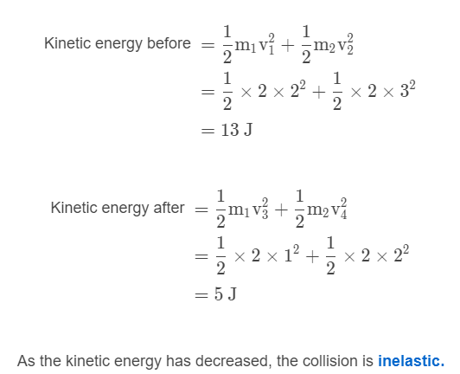

Slide 12
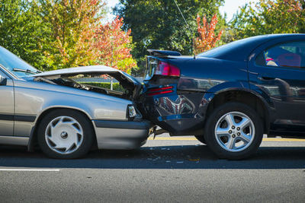
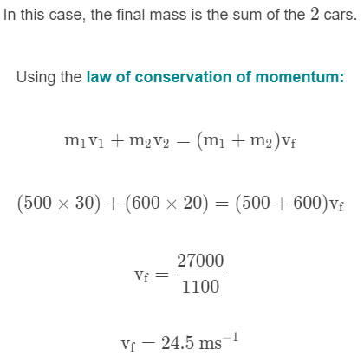
In a perfect inelastic collision, the objects stick together after the collision.
For example, if a 500 kg car driving at 30 ms⁻¹ hits the back of a 600 kg car travelling in the same direction at 20 ms⁻¹, what will be the final velocity (v_{f}​) if the cars stick together during the collision?

Slide 13
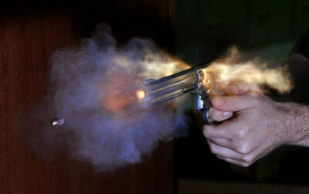
Explosions are the opposite of a collision.
In an explosion, objects move apart from each other.
When a rocket is launched, it uses a controlled explosion to propel it forward, whilst the hot gases are pushed out in the opposite direction. The gain of momentum of the rocket is equal and opposite to the momentum of the hot gases - again the law of conservation of momentum applies.
Similarly, a gun firing a bullet uses an explosion. The bullet gains momentum in the forward direction, whilst the gun recoils with momentum backwards.

Slide 14
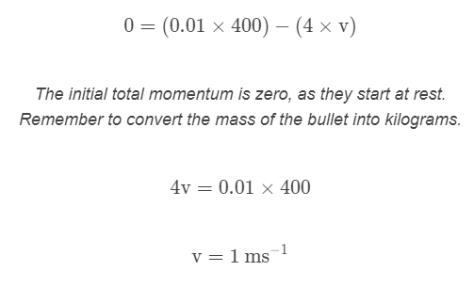

Explosion calculation example.
A bullet of mass 10 g is fired at 400 ms−1 from a rifle of mass 4 kg.
Calculate the recoil velocity (v) of the gun.
Using the law of conservation of momentum:

